Slide 1
Employee Data Analysis using Excel
STUDENT NAME:J.AYEESHA FATHIMA
REGISTER NO:312210287 :asunm1369312210287
DEPARTMENT:B.COM(GENERAL), COMMERCE
COLLEGE : GURU SHREE SHANTIVIJAI JAIN COLLEGE FOR WOMEN

Slide 2
PROJECT TITLE
Employee Performance Analysis using Excel

Slide 3


AGENDA
Problem Statement
Project Overview
End Users
Our Solution and Proposition
Dataset Description
Modelling Approach
Results and Discussion
Conclusion
3/21/2024 Annual Review

Slide 4

PROBLEM STATEMENT
Improve organizational performance
Increase employment opportunities
Enhance employee productivity
Increase employee Engagement and retention
Support strategic decision making
Align employee goals organiational objective
Identify top performers and leaders

Slide 5

PROJECT OVERVIEW
Meaning
Employee performance analysis is a systematic Process of evaluating employee's work performance,productivity,contribution to the organization It involves
To set a clear Goals and expectation
Monitoring progress and performance
Collecting and analysing date
2.Here step by step guide to start employee performance analysis
Data collection
Data analysis
Performance evaluation
Development and planning
Feedback and coaching

Slide 6

WHO ARE THE END USERS?
Employees
Managers
HR department
Organization
CEO/Executive officer
Shareholder
Investor
Customer

Slide 7

OUR SOLUTION AND ITS VALUE PROPOSITION
Filtering = missing values
To find out missed value which we have left.
Conditioning Formatting =blank values
To fill blank values
Pivot table
To provide column based on performance
Chart
To provide chart as per the table which we formed
Empower plus
Employee performance analysis platform

Slide 8
Dataset Description
1.Data set name – Employee performance analysis
2.Description – The data set contains Information on employee performance, including demographic, productivity, evaluation data.
3.Data source : HR data base , performance management software, employees surverys
4. Variables
Demographic variable
Employee id
Name
Job title
Department
Age
Gender
Productivity variable
Sales revenue(Monthly)
Tasks completed[monthly]
Evaluation variable
Performance variable scale 1-5
Peer variable scale 1-5
Manager evaluation scale 1 -5
5 Data format: csv ,excel,SQL
6.Sample size: 1000 employees

Slide 9

THE "WOW" IN OUR SOLUTION
Wow factors:
Al powered predictive analytics
2. Real time feedback and coaching
3. 360 degree evaluation
4.Automated performance tracking
5.Customizable dashboards
6.Mobile accessabilities
7.Integration with existing HR System
8.Continuous learning and development
3/21/2024 Annual Review
9

Slide 10
MODELLING
Input variable
Employee demographic
Job description and variation
Performance analysis components
Goal setting: align employee goal with organizational objective
Performance metrics: Establish Measurable performance indicators
Analytical model
1Descriptive analytics: Summarize employees performance data
2.Predictive analytics: forecast future demand
Statistical techniques
Regression analysis
Correlation analysis
Machine learning Algorithm
Supervised learning
Unsupervised learning
Reinforcement Learning
Data visualization tools:
Bar chart
Histograms
Scatter plot
map
10

Slide 11
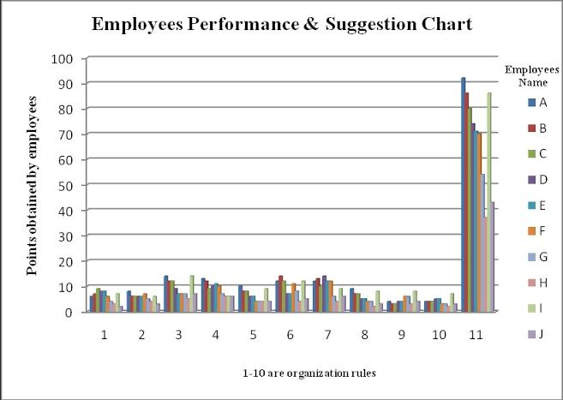
RESULTS
11

Slide 12
conclusion
Employees performance analysis provides Valuable insights in to employee strengths weakness and arrears of improvement
Data driven decision making Enhance employee development, Productivity and retention.
Regular performance analysis Fosters and culture of continuous improvement of growth
It helps for future purpose as well as improve our sills and knowledge

